Slide 1

Predicting weather using Artificial Neural Network
By:
Yanda Saketh (RA1911026010076)
Soumyadeep Mukherjee (RA1911026010078)

Slide 2
Abstract
Weather forecasting has become an important field of research in the last few decades. In most of the cases the researcher had attempted to establish a linear relationship between the input weather data and the corresponding target data. Artificial Neural Network (ANN) has evolved out to be a better technique to bring out the structural relationship between the various entities.

Slide 3
Introduction
Weather forecasting is the application of science and technology to predict the state of the atmosphere for a given location. Weather forecasts are made by collecting quantitative data about the current state of the atmosphere and using scientific understanding of atmospheric processes to project how the atmosphere will evolve

Slide 4
Motivation & Objective
Weather warnings are important forecasts because they are used to protect life and property. Forecasts based on temperature and precipitation are important to agriculture, and therefore to traders within commodity markets. Temperature forecasts are used by utility companies to estimate demand over coming days. On an everyday basis, people use weather forecasts to determine what to wear on a given day.

Slide 5
Why Artificial Neural Network
In order to predict weather in a very effective way and to help overcome all such problems we have proposed a weather forecasting model using Artificial Neural Network. The advantage which ANN has over other weather forecasting method is that the ANN minimizes the error using various algorithms and gives us a predicted value which is nearly equal to the actual value. Such network is simulated over newer data to find out the weather trend in future course

Slide 6
Features
Due to the advancement of modern computer hardware there have been many improvements in numerical weather prediction . We are using ANN which is based on smart analyzing the trend from historical data.
The other models are accurate in calculation but not in predictions the can not able to adapt the irregular patterns of data which can neither be written in form of function or deducted as formula.
Use of ANN will give more accurate result. Here, the error may or may not reduce completely. But, the accuracy will improve as compared to other forecasts.

Slide 7
Introduction to the elements of the model
This Model is build using Artificial Neural Networks.
Key software used:
Jupyter Notebook
Python
Scikit learn
Neural Networks

Slide 8
Literature Review
Mohsen Hayati [5] states that ANN for one day ahead prediction of temperature. Here multilayer perceptron (MLP) is trained for ten years meteorological data from Iran which was divided into four seasons namely spring, summer, fall and winter. MLP is a network of three layers having sigmoid transfer function for hidden layers and linear transfer function for output layer. Hidden neurons were decided using the trial and error method. It was concluded that MLP has minimum prediction error, good performance and reasonable prediction accuracy. They have used historical data for ten years and achieve minimum error and reasonable accuracy

Slide 9
Literature Review
R Lee [10] proposed an innovative, intelligent, multi-agent based environment called as intelligent Java Agent Development Environment (iJADE). It is used for weather prediction of eleven weather stations in Hong Kong using five years data which provides more than 7000 data records. The model uses GA for input node selection, a fuzzy classification for rainfall parameters and neural network for training using a BPN. Its experimental results are more accurate than single point sources using similar network and other networks like Radial Basis Function Network, Learning Vector Quantization and Naive Bayesian Network

Slide 10
Research Methodology
Weather forecasting is an application in meteorology and has been one of the most scientifically and technologically challenging problems around the world in the last century. In this, we are investigating the use of data mining techniques in forecasting maximum temperature, rainfall, evaporation and wind speed. This was carried out using Artificial Neural Network and meteorological data collected from previous 3 years.
Data Collection: the data used for this work was collected from different official websites and Metrological Department. The case data covered the period of 36 months.

Slide 11
Research Methodology
Data Transformation: this step is also known as data consolidation. It is the stage in which the selected data is transformed into forms appropriate for data mining.
Data Mining Stage: It is divided into three phases. At each phase the algorithm is used to analyze the meteorological datasets. The testing method adopted for this research was percentage split that train on a percentage of the dataset, cross validation on it and test on the remaining percentage.

Slide 12
Comparison Between Artificial Neural Network and Back Propagation
An Artificial Neural Network (ANN) is an information processing paradigm that is inspired by the way biological nervous systems, such as the brain, process information. The key element of this paradigm is the new structure of the information processing system.
Components of a modern weather forecasting system include the following modules: data collection, data assimilation and numerical weather prediction.
Data collection: Observations of atmospheric pressure, temperature, wind speed, wind direction, humidity and precipitation are made near the earth’s surface by trained observers, automatic weather stations.

Slide 13
Comparison Between Artificial Neural Network and Back Propagation
Data assimilation: During the data assimilation process, information gained from the observations is used in conjunction with a numerical model most recent forecast for the time that observations were made to produce the meteorological analysis.
Numerical weather prediction: Numerical Weather Prediction (NWP) uses the power of computers to make a forecast. Complex computer programs, also known as forecast models, run on supercomputers and provide predictions on many atmospheric variables such as temperature, pressure, wind and rainfall.

Slide 14
Comparison Between Artificial Neural Network and Back Propagation
Back propagation is a common method of teaching artificial neural networks how to perform a given task. It is a supervised learning method, and is a generalization of the delta rule. It requires a teacher that knows, or can calculate, the desired output for any input in the training set
For better understanding, the back propagation learning algorithm can be divided into two phases: propagation and weight update.
Propagation Each propagation involves the following steps:
1. Forward propagation of a training pattern's input through the neural network in order to generate the propagation's output activations.

Slide 15
Comparison Between Artificial Neural Network and Back Propagation
2. Backward propagation [4] of the propagation's output activations through the neural network using the training pattern's target in order to generate the deltas of all output and hidden neuron.
Weight update For each weight-synapse:
1. Multiply its output delta and input activation to get the gradient of the weight.
2. Bring the weight in the opposite direction of the gradient by subtracting a ratio of it from the weight.

Slide 16
Library Used
To build the model I have used few important libraries namely:
Numpy
Pandas
MLP Classifier
Grid Search CV

Slide 17
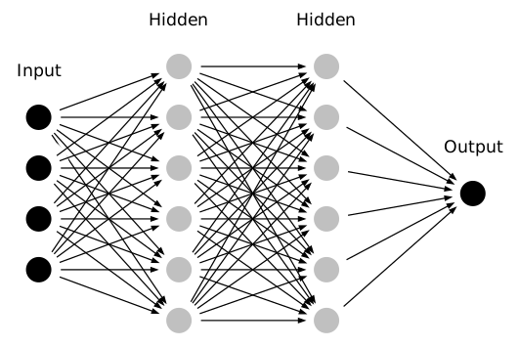
Model

Slide 18
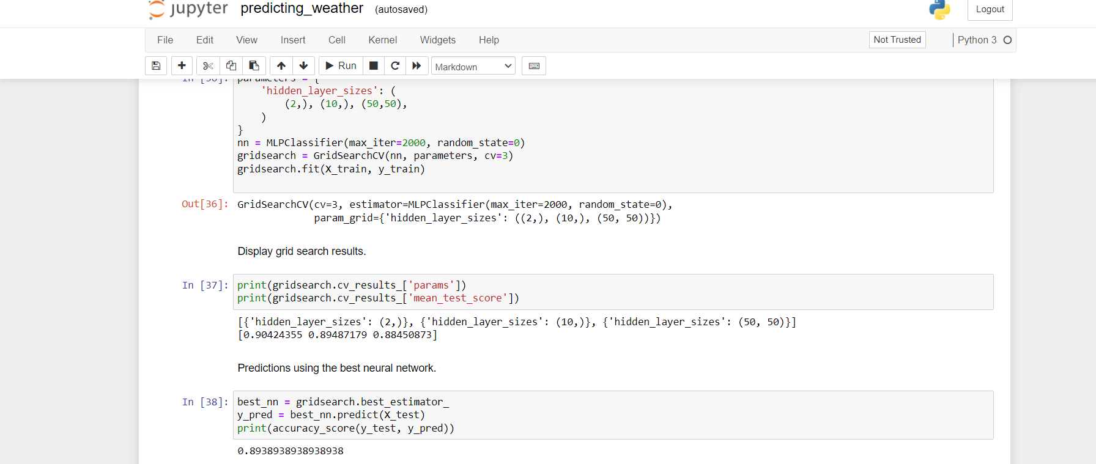
Model
Accuracy

Slide 19
THANK YOU

